Slide 1
Speech acts
Models and Methods
Dasha Popova
31.01.2026

Slide 2
Speech acts
Bilbo Baggins: Good morning!
Gandalf: What do you mean? Do you mean to wish me a good morning or do you mean that it is a good morning whether I want it or not… or perhaps you mean to say that you feel good on this particular morning.. or are you simply stating that this is a morning to be good on?
Bilbo Baggins: All of them at once, I suppose.
The Hobbit. An Unexpected Journey

Slide 3
Speech acts
Speech act is a minimal unit of communication
Take an umbrella with you!
Happy Birthday!
Today we are discussing speech acts
Three components of a speech act:
An illocutionary act is the speaker’s intention behind the act. The illocutionary force of an utterance is another name for the act behind that utterance. For example, an utterance might be said to have the force of a question or a promise.
A locutionary act is an instance of using language.
A perlocutionary act or effect is an additional effect that comes about through performing an illocutionary act.
(Of course, perlocutionary effects are only partially under the speaker’s control; I might intend my utterance to have one effect, only to find that my audience perceived a very different one. This will result in a communicative failure)

Slide 4
Speech acts
Three components of a speech act:
An illocutionary act is the speaker’s intention behind the act. The illocutionary force of an utterance is another name for the act behind that utterance. For example, an utterance might be said to have the force of a question or a promise.
A locutionary act is an instance of using language.
A perlocutionary act or effect is an additional effect that comes about through performing an illocution-
ary act. (Of course, perlocutionary effects are only partially under the speaker’s control; I might intend my
utterance to have one effect, only to find that my audience perceived a very different one. This will result in a communicative failure)
Performatives: direct encoding of illocution – testing with hereby
a. I hereby promise to bring candy to the last class. (a promise)
b. I hereby fry an egg. (not an egg-frying)
c. I hereby insult you. (an act of insulting?)
d. Your cooking is terrible. (might be an act of insulting)

Slide 5
Speech acts
Three components of a speech act:
An illocutionary act is the speaker’s intention behind the act. The illocutionary force of an utterance is another name for the act behind that utterance. For example, an utterance might be said to have the force of a question or a promise.
A locutionary act is an instance of using language.
A perlocutionary act or effect is an additional effect that comes about through performing an illocution-
ary act. (Of course, perlocutionary effects are only partially under the speaker’s control; I might intend my
utterance to have one effect, only to find that my audience perceived a very different one. This will result in a communicative failure)
Direct vs. indirect speech acts:
Open the window! (direct)
It is so stuffy in here! (indirect)

Slide 6
Sentence types and illocutionary acts
Sentence type:
– declarative:
Ducks are amazing.
I wonder where Anna is.
You should move your car.
You can have a muffin.
It would be a shame if something happened to your store.
– interrogative:
Is today Saturday?
What day is today?
What on earth are you doing?
Do you want to have ice-cream?
Could you help me?
– imperative:
Move your car!
Have a muffin!
Please rain!
Get well soon!
Turn right here.
What speech acts correspond to (1) - (15)?

Slide 7
Sentence types and illocutionary acts
Sentence type: Act:
– declarative:
Ducks are amazing. assertion
I wonder where Anna is. question
You should move your car. suggestion
You can have a muffin. invitation
It would be a shame if something happened to your store. threat
– interrogative:
Is today Saturday? question
What day is today? question
What on earth are you doing? accusation
Do you want to have ice-cream? invitation
Could you help me? request
– imperative:
Move your car! command
Have a muffin! invitation
Please rain! plea
Get well soon! well-wish
Turn right here. request

Slide 8
Sentence type conventions
Declarative convention: If a speaker S utters a declarative sentence with propositional content p, then S thereby commits to acting as though she believes p.
Imperative convention: If a speaker S utters an imperative with content p, then S thereby commits to having an effective preference for p.
Interrogative convention: If a speaker S utters an interrogative with content Q, then S thereby commits to a preference for the hearer to commit himself to acting as though he believes an answer to Q.
(Lauer 2013)

Slide 9
Properties of illocutionary acts and illocutionary force (Green 2007)
i. Illocutionary point: This is the characteristic aim of each type of speech act. For instance, the characteristic aim of an assertion is to describe how things are; the characteristic point of a promise is to commit oneself to a future course of action.
ii. Degree of strength of the illocutionary point: Two illocutions can have the same point but differ along the dimension of strength. For instance, requesting and insisting that the addressee do something both have the point of attempting to get the addressee to do that thing; however, the latter is stronger than the former.
iii. Mode of achievement: This is the special way, if any, in which the illocutionary point of a speech act must be achieved. Testifying and asserting both have the point of describing how things are; however, the former also involves invoking one’s authority as a witness while the latter does not. To testify is to assert in one’s capacity as a witness. Commanding and requesting both aim to get the addressee to do something; yet only someone issuing a command does so in her capacity as a person in a position of authority.
iv. Propositional content conditions: Some illocutions can only be achieved with an appropriate propositional content. For instance, I can only promise what is in the future and under my control. I can only apologize for what is in some sense under my control and already the case. For this reason, promising to make it the case that the sun did not rise yesterday is not possible; neither can I apologize for the truth of Snell’s Law.

Slide 10
Properties of illocutionary acts and illocutionary force (Green 2007)
v. Preparatory conditions: These are all other conditions that must be met for the speech act not to misfire. Such conditions often concern the social status of interlocutors. For instance, a person cannot bequeath an object unless she already owns it or has power of attorney; a person cannot marry a couple unless she is legally invested with the authority to do so.
vi. Sincerity conditions: Many speech acts involve the expression of a psychological state. Assertion expresses belief; apology expresses regret, a promise expresses an intention, and so on. A speech act is sincere only if the speaker is in the psychological state that her speech act expresses.
vii. Degree of strength of the sincerity conditions: Two speech acts might be the same along other dimensions, but express psychological states that differ from one another in the dimension of strength. Requesting and imploring both express desires, and are identical along the other six dimensions above; however, the latter expresses a stronger desire than the former.

Slide 11
Practice: compliments
– Wierzbicka (1987: 201):
(1) I perceive something good about your Y.
(2) I'd like to say a good thing about you because of that.
(3) I say something good about X and X’s Y.
– Jacob et al. (1993:6):
A. The Propositional Conditions: The S must indicate a positive value for an attribute, state, or event.
B. The Preparatory Conditions: The S must have positive value, the attribute must be noteworthy, and the H must be able to take credit for the attribute.
C. The Sincerity Condition: The S must approve the attribute; state or event being mentioned.
D. The Essential Conditions: The utterance counts as a recognition and approval of the attribute, state, or event credited to the hearer.
What perlocutionary effect do we expect?
Could a compliment result in a communicative failure?
Could a different speech act be disguised as a compliment?
Could a compliment be mistaken for a different speech act?
What speech acts are in the compliment family: praise, acknowledgement…?
How do we distinguish between those?
Which sentence types could be used in a compliment?

Slide 12
Practice: direct and indirect speech acts
Solan & Tiersma (2005:61):
These findings suggest that the legal system should begin to recognize indirect requests for counsel, just as they recognize indirect requests by the police to search a car, and just as they recognize indirect acts of consent by suspects. At the very least, law enforcement officers should be required to explain, once a suspect raises the right to counsel, that his request will be respected and that if he wants to have a lawyer present, all he has to do is say “I want a lawyer.”
The law is now settled and contains no such requirement. In 1994 – the year after Ainsworth’s article was published in the Yale Law Journal – the Supreme Court held in Davis v. United States that a suspect’s statement that “Maybe I should talk to a lawyer” was not an invocation of the right to counsel, adopting the literalistic threshold of clarity approach. The Court also held that interrogating officers were under no duty to ask clarifying questions, emphasizing that unless and until a suspect makes an unambiguous or unequivocal request for counsel, the police can continue questioning. The ruling was especially aggressive in rejecting the clarification standard, which the government itself had agreed may be the best path to take when a suspect makes an equivocal invocation.

Slide 13
Practice: direct and indirect speech acts
(1) I hereby invoke my right to counsel. – to invoke your right to counsel in the U.S.
Courts have ruled that all of the following fail to invoke the right to counsel:
(2) a. “Maybe I need a lawyer.”
b. “I think I need a lawyer.”
c. “Didn’t you say I have the right to an attorney?”
d. “Wait a minute. Maybe I ought to have an attorney.”
Why do you think people might use indirect speech acts in (2), as opposed to a direct speech act in (1)?
For comparison, all of the following have been interpreted by courts as successful instances of police requesting that they be allowed to search people or their motor vehicles:
(Solan & Tiersma 2005:§3):
(3) a. “You don’t mind if we look in you trunk, do you?”
b. “Do you mind if I check it [luggage]?”
c. “Do you mind if I take a look?”
d. “Can I have permission to search your vehicle?”

Slide 14
Practice: a request or a suggestion?
Solan & Tiersma (2005:181):
Not only is it illegal to commit a crime, but people can also be punished for asking or inducing someone else to do so. This is the crime of solicitation. Usually, the law punishes only the solicitation of more serious crimes. The state must usually prove that the solicitor intended the crime to be committed, although the crime does not actually have to be carried out. What is essential, at least under federal law, is that the solicitor “solicits, commands, induces, or otherwise endeavors to persuade” someone else to engage in the crime. The essence of solicitation is language.
Wierzbicka (1987:187):
Utterance U is a suggestion iff
a. I say that I think that it would be a good thing if you did the act described by U;
b. I say this because I want you to think about it;
c. I do not know whether you will do it; and
d. I do not want to say that I want you to do it.

Slide 15
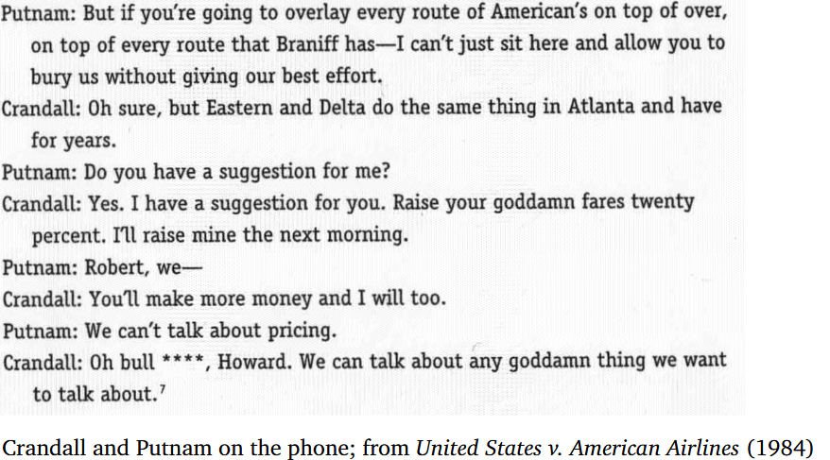
Practice: a request or a suggestion?
Solan & Tiersma (2005:184):
Another relatively obvious example of a request involved Robert Crandall, the president of American Airlines. Crandall was accused by the federal government of soliciting Howard Putnam, president of Braniff Airlines, to engage in an attempt to monopolize the airline business in the Dallas-Fort Worth area. Both airlines had their hub at the Dallas-Fort Worth airport, and competition between them was intense; as a result, neither airline made much money. One day, Crandall telephoned Putnam about the problem:

Slide 16
Practice: a request or a suggestion?
Solan & Tiersma’s questions: Did Crandall “request” Putnam to violate the antitrust laws by conspiring to set prices? Or is this merely a suggestion, which is what Crandall himself labeled it, and which would not be criminal

Slide 17
References
Austin J. L. (1962). How to do things with words. Oxford University Press.
Green, Mitchell. 2007. Speech acts. In Edward N. Zalta (ed.), The Stanford encyclopedia of philosophy, http://plato.stanford.edu/entries/speech-acts/.
Jacob, S., M. Aakhus, and Aldrich, A. (1993). This is a really great paper: How to recognize a compliment. Paper presented at the Annual Convention of the International Communication Association, Washington, DC.
Lauer, Sven. 2013. Towards a dynamic pragmatics: Stanford University dissertation.
Searle J. (1969). Speech Acts. Cambridge: Cambridge University Press.
Solan, Lawrence M. & Peter M. Tiersma. 2005. Speaking of crime: The language of criminal justice. Chicago: University of Chicago Press.
Strawson P. (1964). Intention and convention in speech acts // The Philosophical Review. Vol. 73. P. 439–460.
Wierzbicka, Anna. 1987. English speech act verbs: A semantic dictionary. New York: Academic Press.

